Slide 1
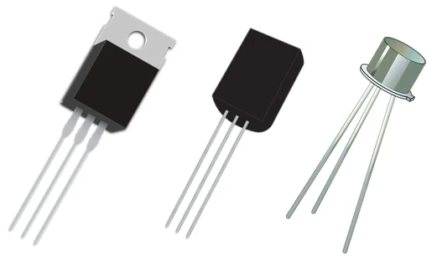
Transistors
and other announcements

Slide 2
A bit about me
Name: Ana
Year: 12
Subjects: Maths AA HL, Computer Science HL, Physics HL
Experience: Java, Python, C#, Arduino/Raspberry Pi, Robotics Club in Y10

Slide 3
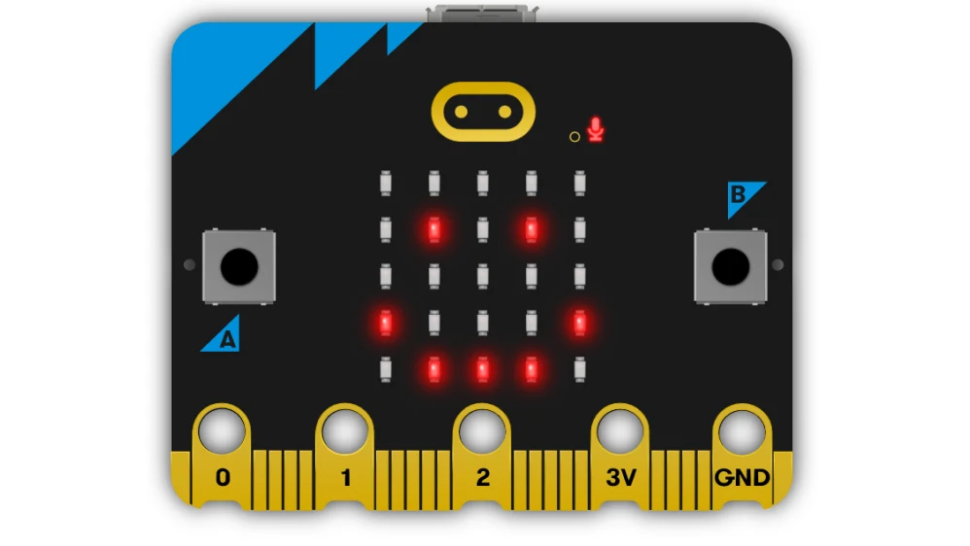
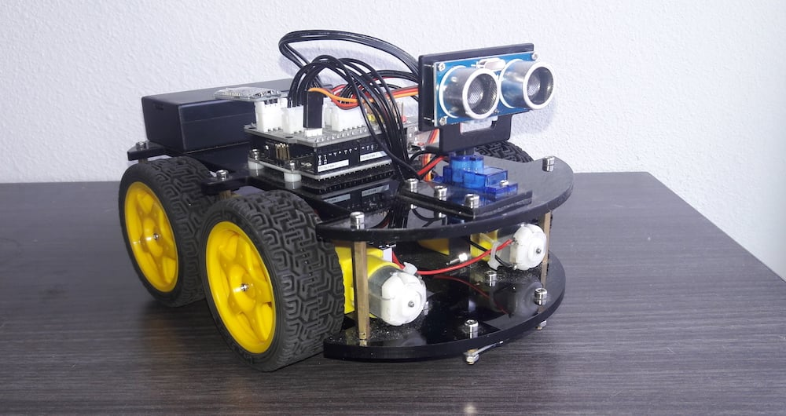
Future plans
Will likely get microbit kits
Will look into ordering robot parts (probably going to start with ultrasonic sensor robots)
If anyone is interested in competitions/contests we can look into those soon!

Slide 4
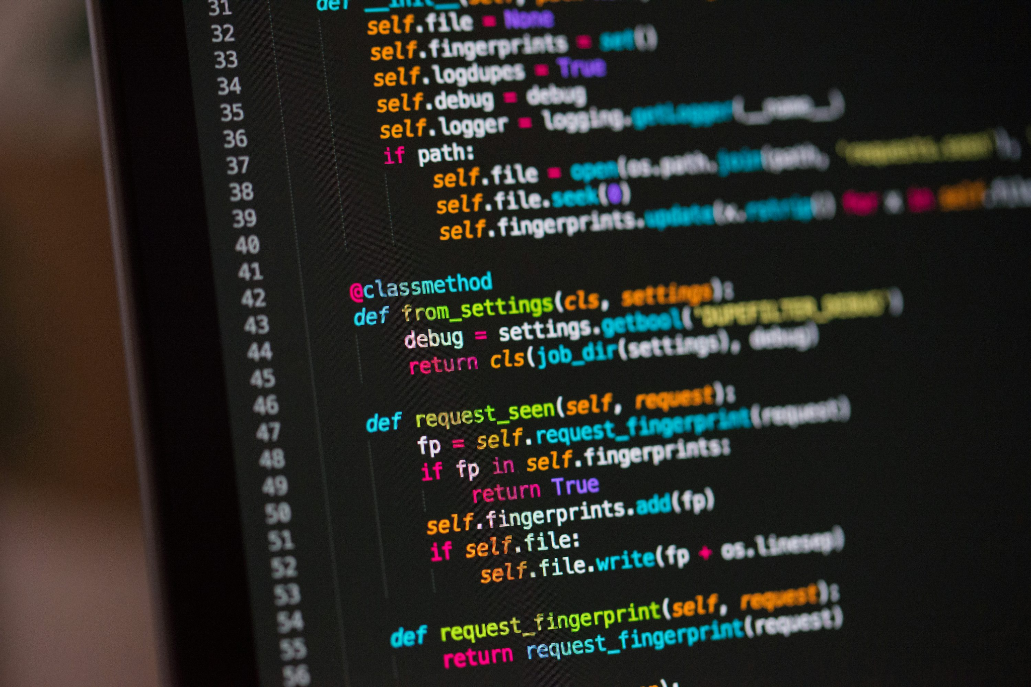
Coding Club!
Will likely run on a Thursday
Will likely be run by me and a couple of other Y12s
Python, Java, etc…
Mix of lessons and practicals, with a project at the end
Interested?

Slide 5
What is a Transistor?
“A transistor is a semiconductor device used to amplify or switch electrical signals and power. It is one of the basic building blocks of modern electronics. It is composed of semiconductor material, usually with at least three terminals for connection to an electronic circuit.”
Wikipedia states that:
So what does it actually do?
Notes:
https://en.wikipedia.org/wiki/Transistor#:~:text=A%20transistor%20is%20a%20semiconductor,connection%20to%20an%20electronic%20circuit.

Slide 6

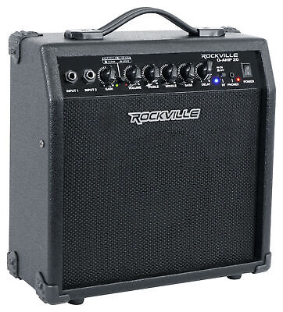
What does a Transistor do?
Transistors act with two main functions:
Switch: can turn a current on or off
Amplifier: can take a small electrical signal and make it stronger

Slide 7
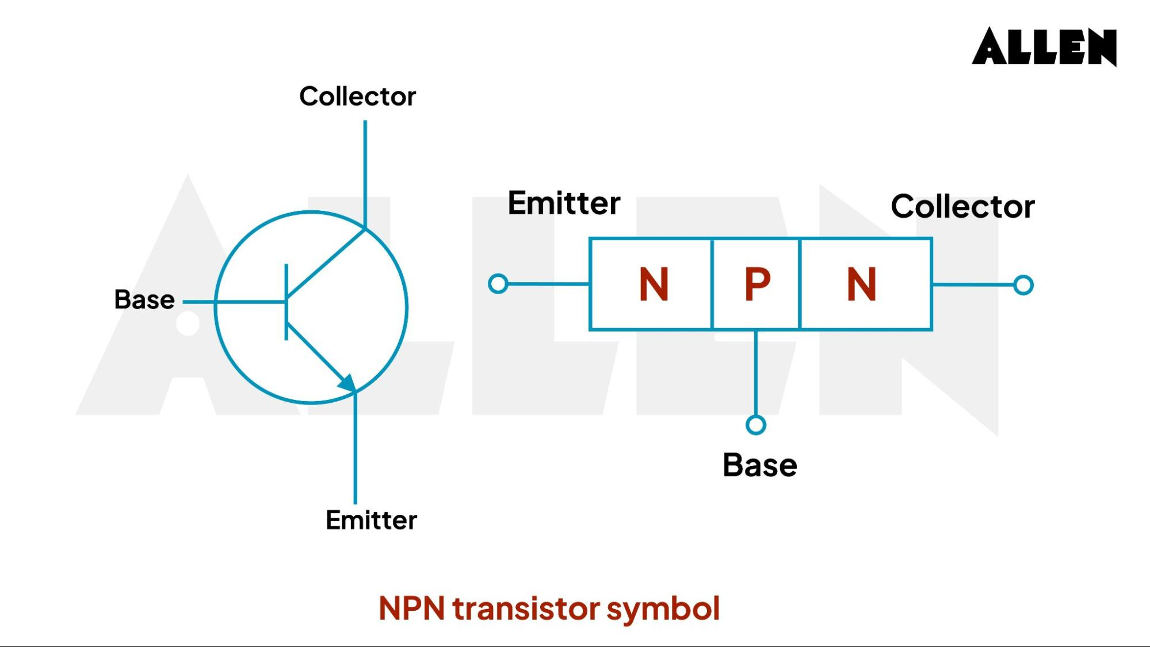
Transistor Pins

Slide 8
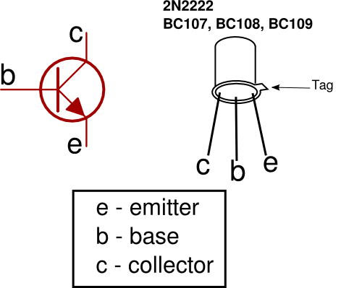
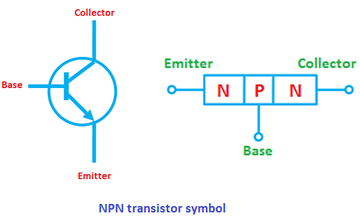
Transistor Pins

Slide 9
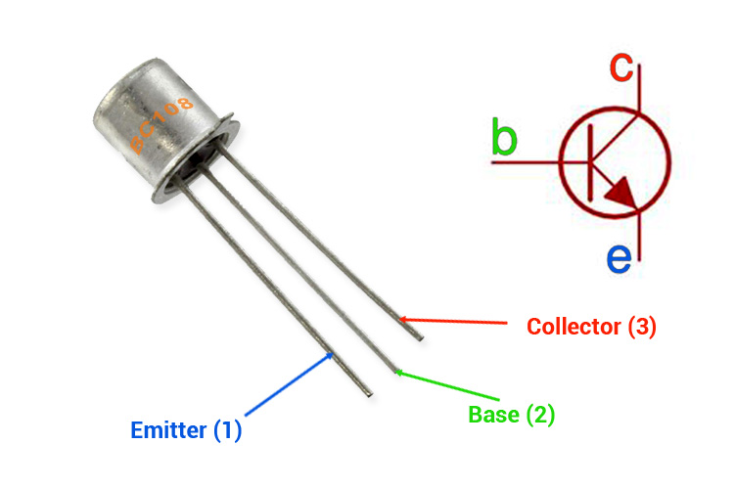
Transistor Pins

Slide 10
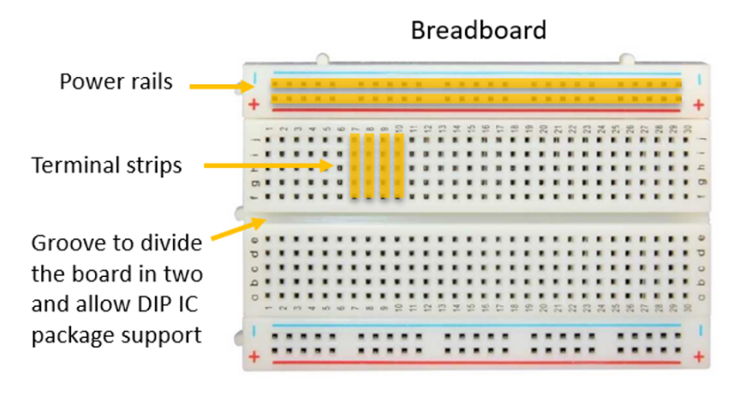
Reminder…

Slide 11
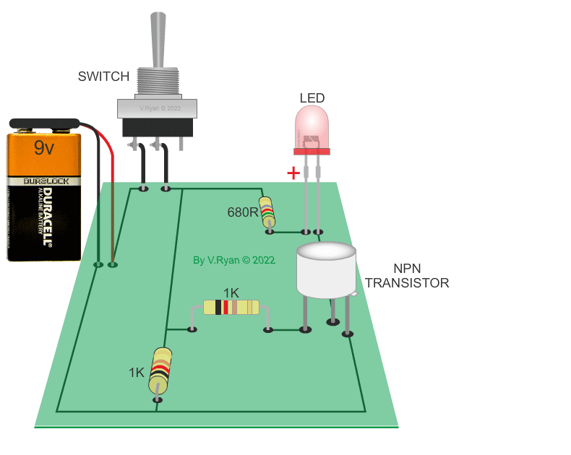
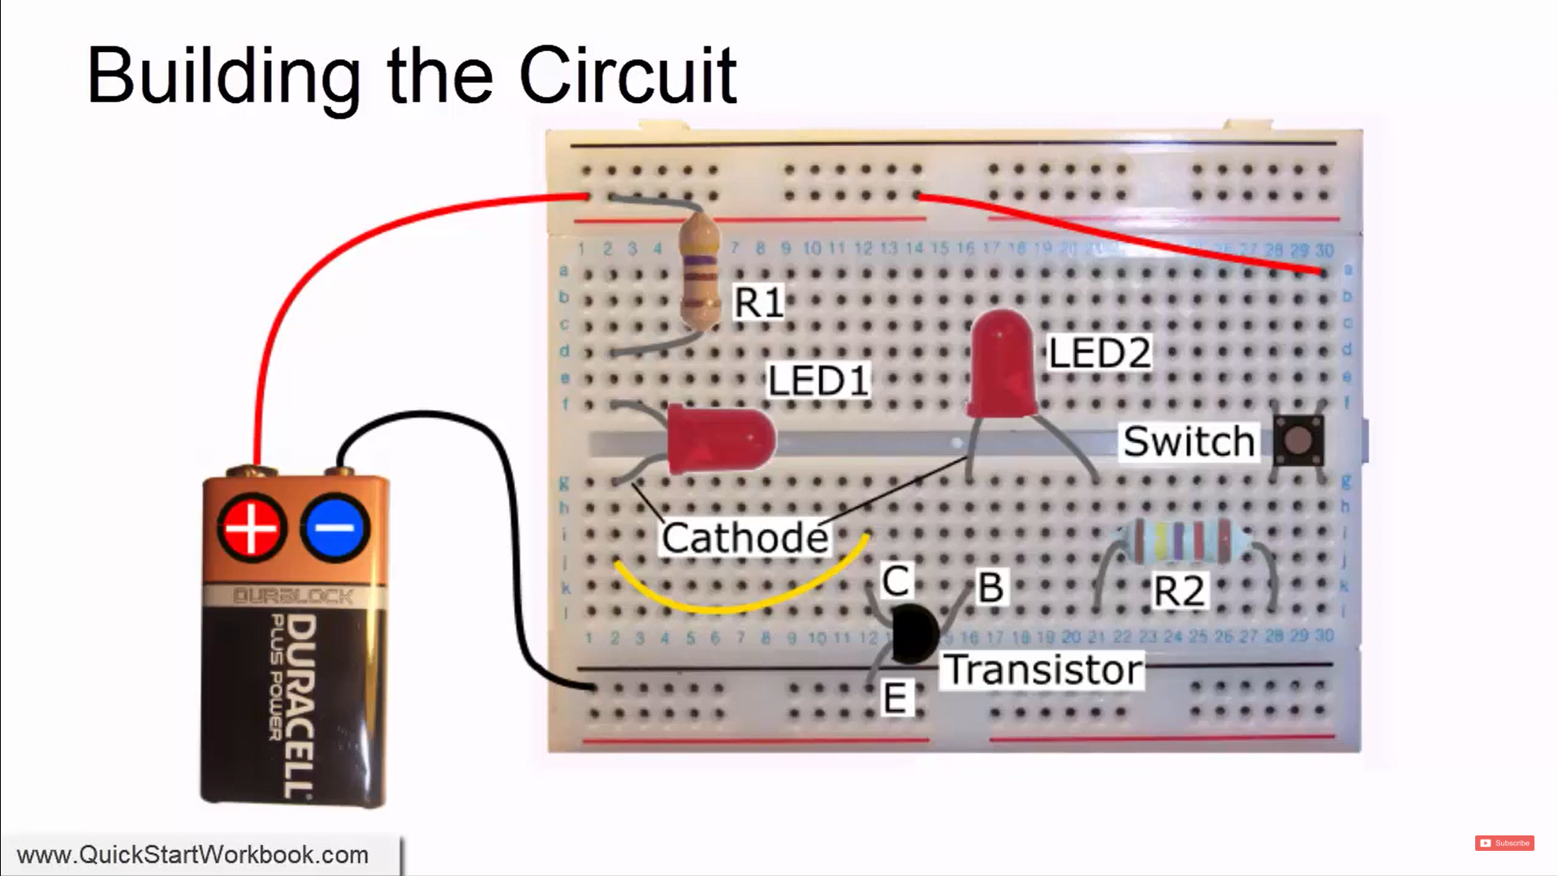
Using Transistors

Slide 14
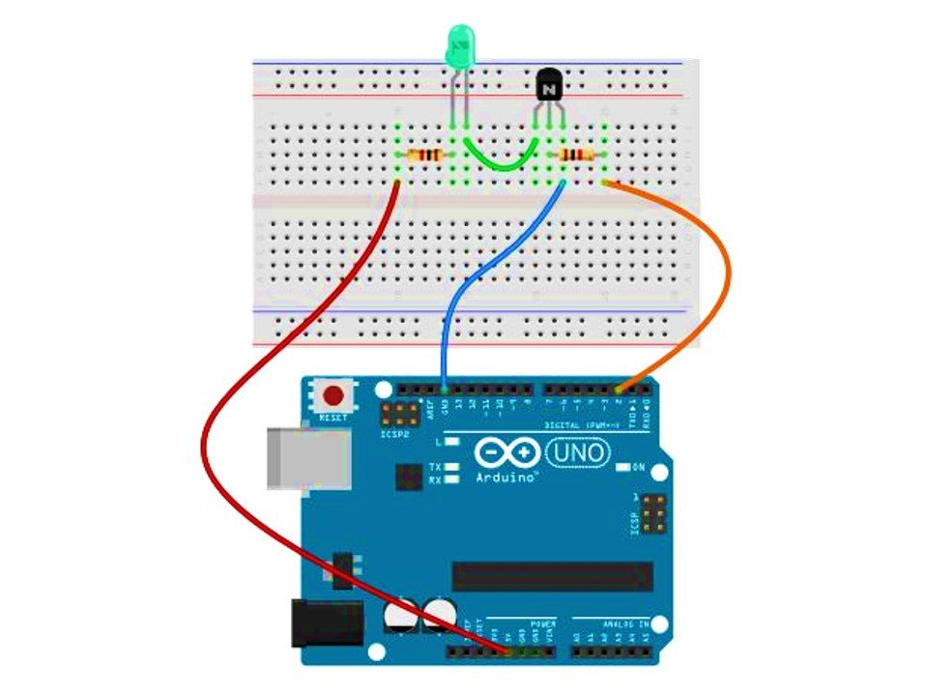
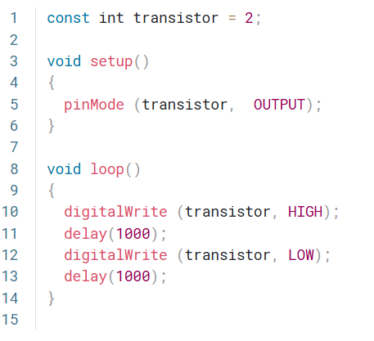
Using Transistors – With Code
Notes:
https://projecthub.arduino.cc/SBR/switching-using-transistor-18cb61

